Slide 1
DDoS Attack Detection using Machine Learning
Minor Project By:
Rajpurohit Bhavani Singh
(A217131522045)

Slide 2
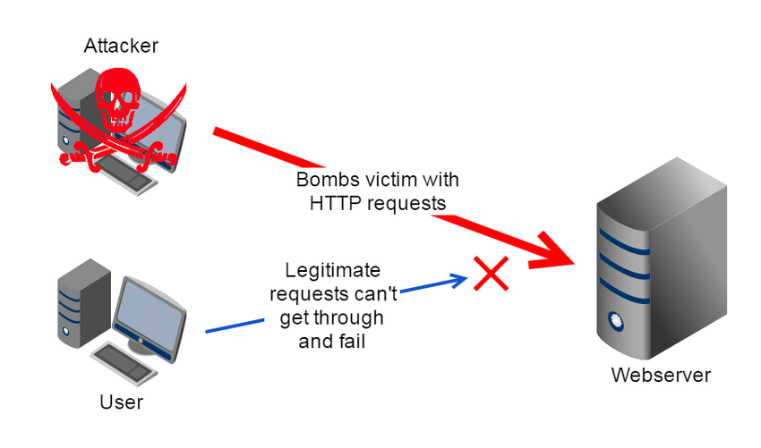
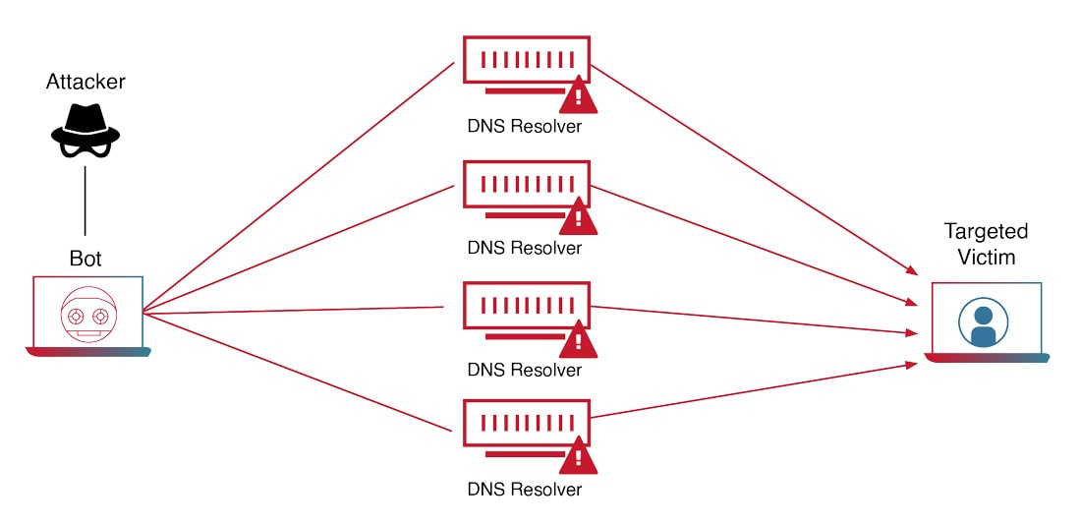
What is Distributed Denial of Service
A distributed denial-of-service (DDoS) attack is a malicious attempt to disrupt the normal traffic of a targeted server, service or network by overwhelming the target or its surrounding infrastructure with a flood of Internet traffic.
DDoS attacks achieve effectiveness by utilizing multiple compromised computer systems as sources of attack traffic. Exploited machines can include computers and other networked resources such as IoT devices.
A Distributed Denial-of-Service (DoS) attack is an attack meant to shut down a machine or network, making it inaccessible to its intended users.
Victims of DoS attacks often target web servers of high-profile organizations such as banking, commerce, and media companies, or government and trade organizations.

Slide 3
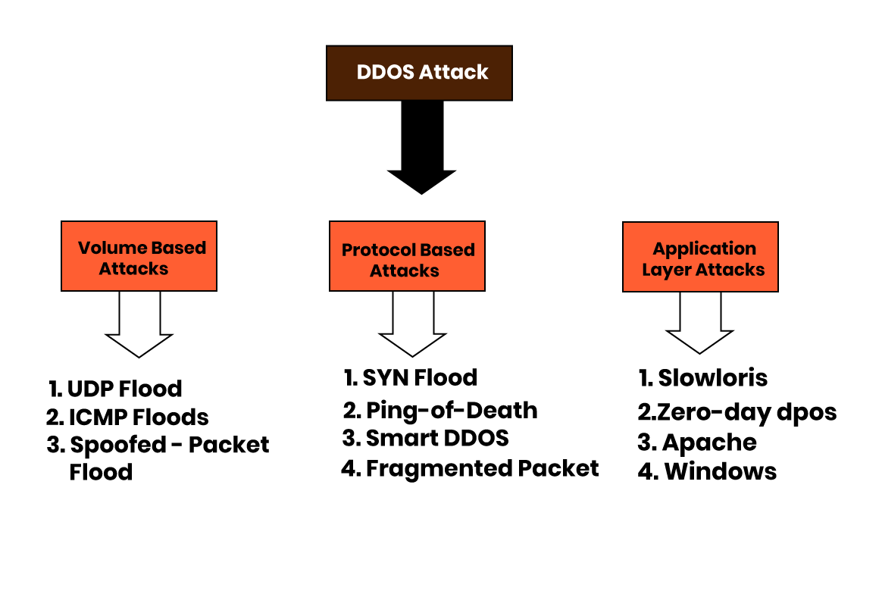
Types of DoS Attacks
Different attacks target different parts of a network, and they are classified according to the network connection layers they target.
A connection on the internet is comprised of seven different “layers," as defined by the Open Systems Interconnection (OSI) model created by the International Organization for Standardization. The model allows different computer systems to be able to "talk" to each other.

Slide 4
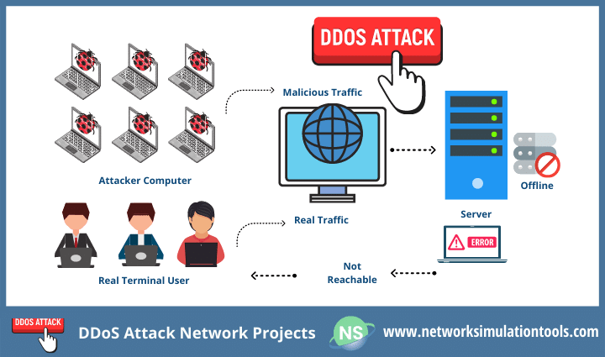
Volume-Based or Volumetric Attacks
This type of attack aims to control all available bandwidth between the victim and the larger internet. Domain name system (DNS) amplification is an example of a volume-based attack. In this scenario, the attacker spoofs the target's address, then sends a DNS name lookup request to an open DNS server with the spoofed address.
When the DNS server sends the DNS record response, it is sent instead to the target, resulting in the target receiving an amplification of the attacker’s initially small query.

Slide 5
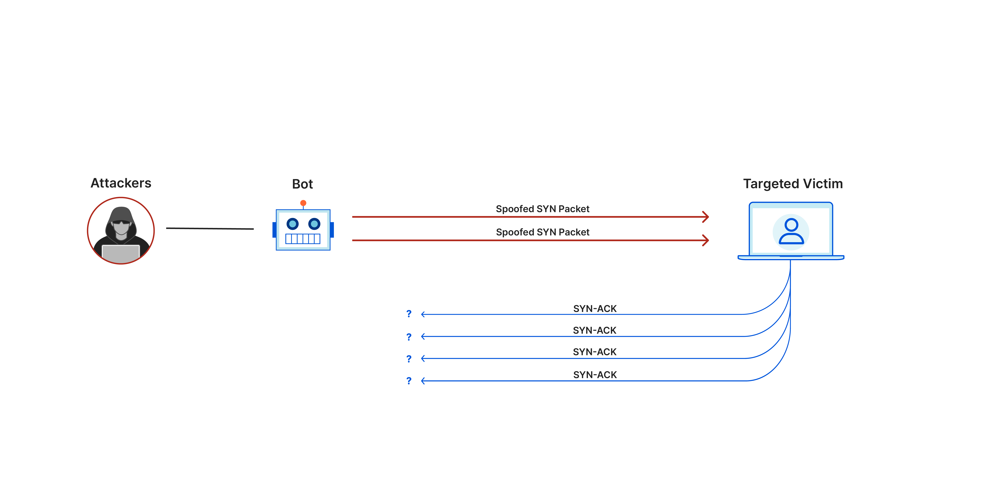
Protocol Attacks
Protocol attacks consume all available capacity of web servers or other resources, such as firewalls. They expose weaknesses in Layers 3 and 4 of the OSI protocol stack to render the target inaccessible.
A SYN flood is an example of a protocol attack, in which the attacker sends the target an overwhelming number of transmission control protocol (TCP) handshake requests with spoofed source Internet Protocol (IP) addresses.
The targeted servers attempt to respond to each connection request, but the final handshake never occurs, overwhelming the target in the process.

Slide 6
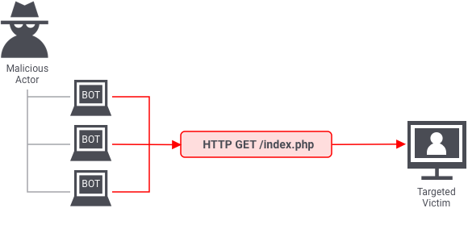
Application-Layer Attacks
These attacks also aim to exhaust or overwhelm the target's resources but are difficult to flag as malicious. Often referred to as a Layer 7 DDoS attack—referring to Layer 7 of the OSI model—an application-layer attack targets the layer where web pages are generated in response to Hypertext Transfer Protocol (HTTP) requests.
A server runs database queries to generate a web page. In this form of attack, the attacker forces the victim's server to handle more than it normally does.
An HTTP flood is a type of application-layer attack and is similar to constantly refreshing a web browser on different computers all at once. In this manner, the excessive number of HTTP requests overwhelms the server, resulting in a DDoS.

Slide 7
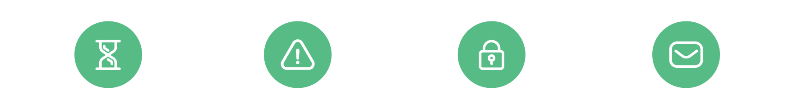
Signs of DDoS attack
Degradation
in Network Performance
Especially when attempting
to open files stored on the network or when accessing websites
Specific Website Unavailable
A particular site does not open or cannot be found
Inability to Access Any Website
All websites are inaccessible on the network
High Volume of Email Spam
A higher than usual volume of spam email.

Slide 8
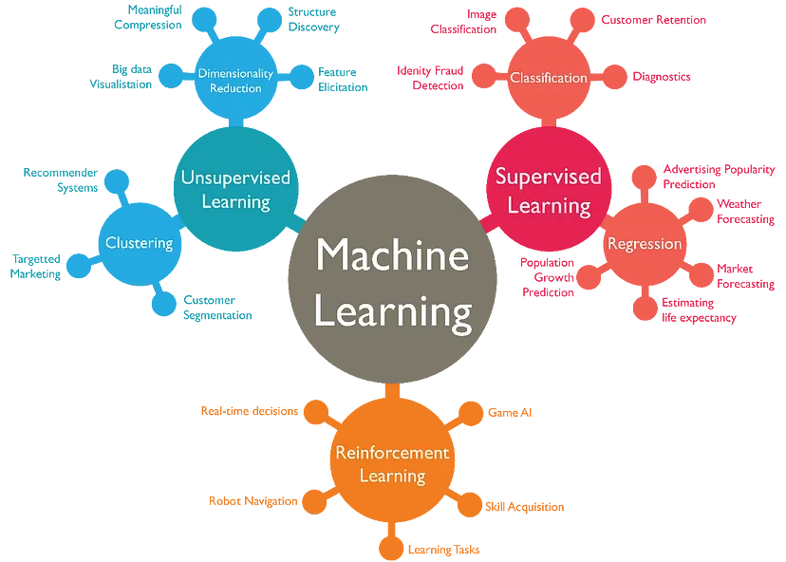
Role of machine learning in DDoS Attack Detection
Machine learning is pivotal in DDoS attack detection, leveraging anomaly recognition to identify deviations in network traffic and establish normal behavior baselines. Its real-time capabilities enable automated responses, dynamically adjusting configurations to promptly mitigate DDoS impact and reduce downtime.
The adaptive nature of machine learning ensures ongoing defense, continuously learning from new data to stay ahead of evolving DDoS attack tactics, providing robust protection against emerging threats.

Slide 9
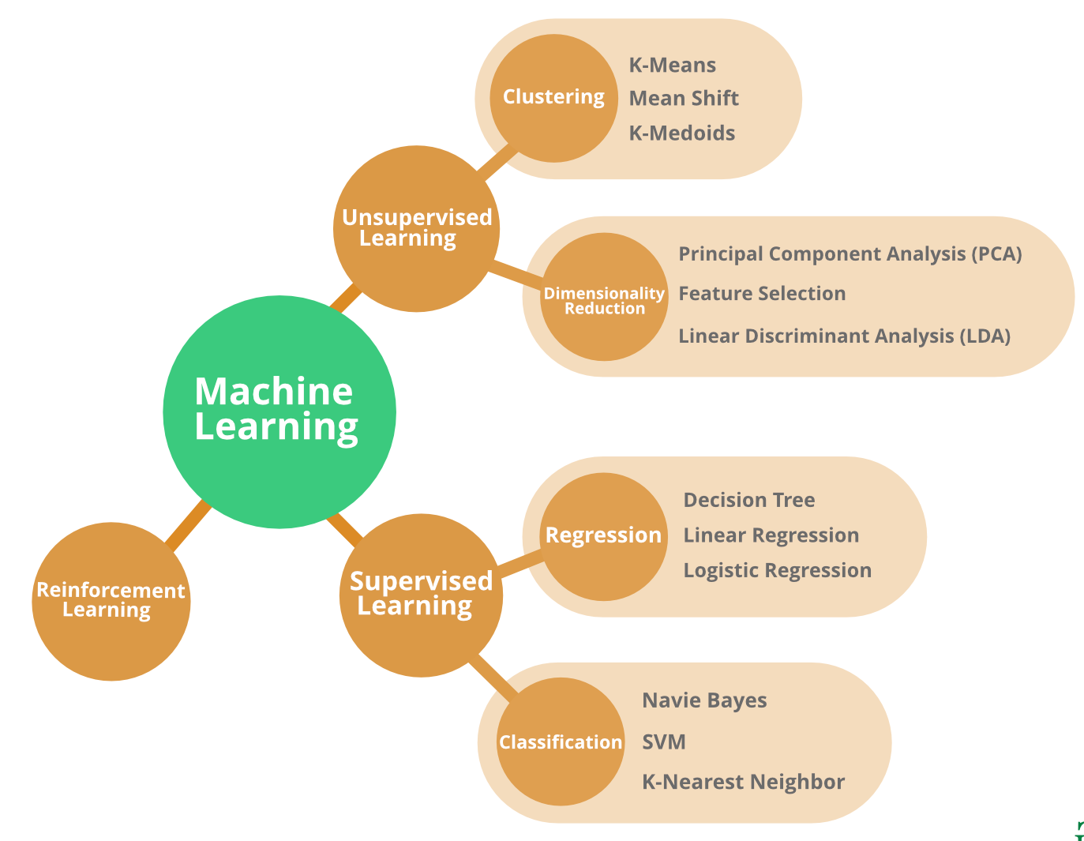
Machine Learning Algorithms
Supervised learning: In supervised learning the machine learning algorithm learns from labelled data
Unsupervised Learning: In unsupervised learning the machine learning algorithm learns from unlabelled data.
Reinforcement Learning: Reinforcement learning is an area of machine learning concerned with how intelligent agents take action in an environment to maximize its reward.

Slide 10
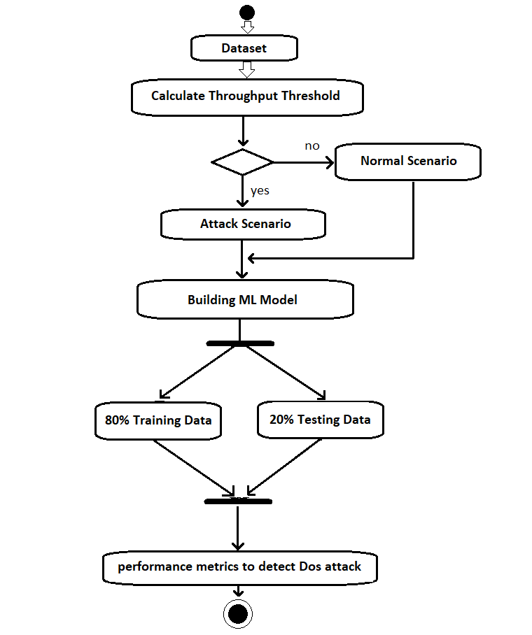
How to detect Dos using Machine Learning
A Dataset is considered as the throughput threshold.
The original dataset consisting of 29,053 records is categorized into a 80:20 ratio. That is, 80% of the data is considered as training data, and the rest of 20% of the data is test data.
machine learning models are built; In general, logistic regression is used for prediction analysis and Naive Bayes assumes conditional independence for all features.

Slide 11
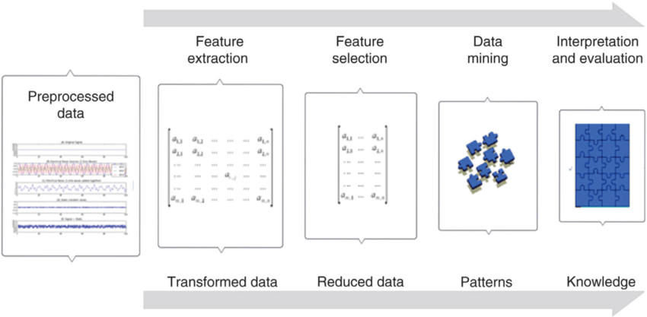
Feature Extraction
Feature extraction involves selecting the most relevant features from the data.
The selected features should be able to distinguish between normal and malicious traffic.
Feature extraction can be done manually or using automated techniques.

Slide 12
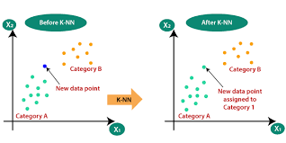
Classifier Used
K-Nearest Neighbors:
K-Nearest Neighbor's is one of the most basic yet essential classification algorithms in Machine Learning. It belongs to the supervised learning domain and finds intense application in pattern recognition, data mining, and intrusion detection.
The 'k' in KNN represents the number of nearest neighbors considered when making predictions. Selecting an appropriate 'k' value is crucial; a smaller 'k' increases sensitivity to local patterns, while a larger 'k' provides a smoother decision boundary but may be influenced by noise.
KNN follows a lazy learning approach. During training, it retains the entire dataset. When a new image needs classification, KNN looks up the k-nearest neighbors in the stored dataset and predicts the class based on their majority. This laziness makes KNN flexible but may lead to slower predictions for large datasets due to the need to compute distances for each prediction
example: dataset of images labeled as "cat" or "dog

Slide 13
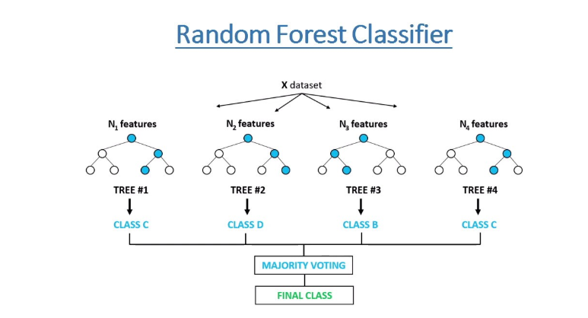
Random Forest:
Random Forest combines multiple decision trees to create a robust and accurate model. Each tree is trained on a random subset of the data, and their predictions are averaged or voted upon to improve generalization. This prevents the dominance of specific features, increasing the model's resilience to noise and outliers, and contributing to improved overall predictive accuracy
It provides a measure of feature importance, helping to identify which features contribute the most to the model's predictive performance. This information is valuable for feature selection and gaining insights into the underlying data patterns.
By aggregating predictions from multiple trees, Random Forest mitigates overfitting, a common issue in individual decision trees. The randomness introduced during training enhances model generalization, making it more resilient to noise and outliers in the data.

Slide 14
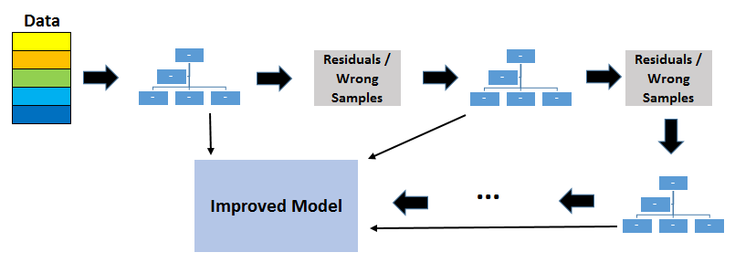
Gradient Boosting Classifier Model
Gradient Boosting is a functional gradient algorithm that repeatedly selects a function that leads in the direction of a weak hypothesis or negative gradient so that it can minimize a loss function. Gradient boosting classifier combines several weak learning models to produce a powerful predicting model.
The main idea behind this algorithm is to build models sequentially and these subsequent models try to reduce the errors of the previous model. But how do we do that? How do we reduce the error? This is done by building a new model on the errors or residuals of the previous model.
When the target column is continuous, we use Gradient Boosting Regressor whereas when it is a classification problem, we use Gradient Boosting Classifier. The only difference between thetwo is the “Loss function”. The objective here is to minimize this loss function by adding weak learners using gradient descent. Since it is based on loss function hence for regression problems, we’ll have different loss functions like Mean squared error (MSE) and for classification.
e.g log-likelihood.

Slide 15
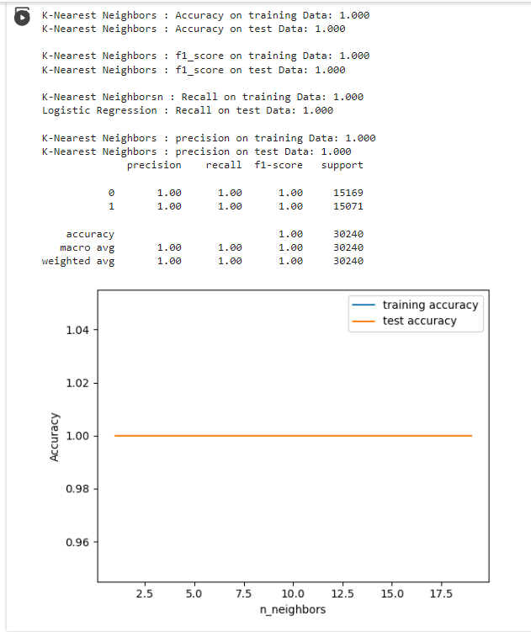
Accuracy
Logistic Regression:

Slide 16
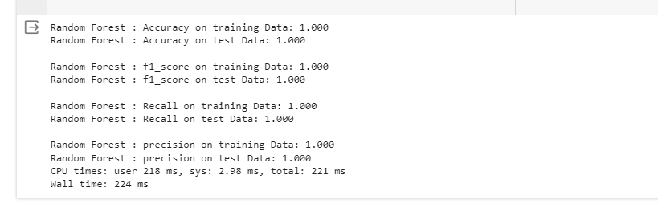
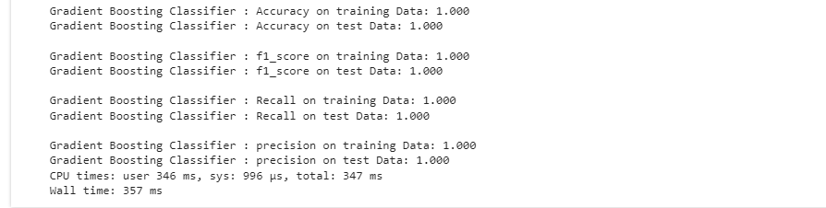
II. Random Forest:
Gradient Boosting Classifier:

Slide 17
Result and Conclusion
Upon loading the dataset, visualizing it, splitting the dataset and then training it and testing it against the various pre-existing Machine Learning classifiers as present above. It is possible to conclude that, the dataset is very clean and it is possible for all of these ML classifier algorithms to draw a line and detect if the network log is a DDOS Attack or not. The metrics of the algorithms remain unchanged and also playing around with the features has not resulted in any significant change. So now the only way to pick an optimal algorithm is on the basis of run time.

Slide 18
Random Forest
K Nearest Neighbors
Gradient Boosting Classifier
Random Forest | Time Taken (m.s)
Try 1 | 42.5
Try 2 | 49.1
Try 3 | 42.8
Try 4 | 44.2
Try 5 | 58
Try 6 | 48
Try 7 | 42
Try 8 | 48.5
Try 9 | 40.6
Try 10 | 52.8
Average | 46.85
Gradient Boosting Classifier | Time Taken (m.s)
Try 1 | 57.1
Try 2 | 42.6
Try 3 | 40.3
Try 4 | 44.7
Try 5 | 47.6
Try 6 | 43.1
Try 7 | 44.9
Try 8 | 42.9
Try 9 | 44.9
Try 10 | 49.5
Average | 45.76
K Nearest Neighbors | Time Taken
Try 1 | 41.8
Try 2 | 54.7
Try 3 | 41
Try 4 | 56.1
Try 5 | 42.6
Try 6 | 41.1
Try 7 | 42
Try 8 | 44.4
Try 9 | 41.2
Try 10 | 58.6
Average | 46.35
I've calculated the average of 10 run times of each ML classifier as listed below and out of which, the most optimal algorithm is Gradient Boosting Classifier with an Average run time of 45.76 ms.

Slide 19
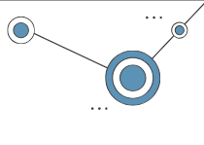
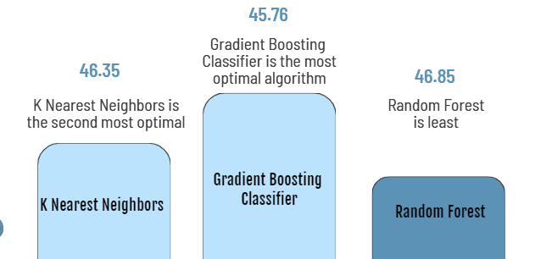
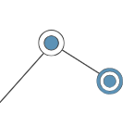
Hence, I conclude that in the comparative study for finding the optimal algorithm for DDOS Detection, in the given scenario and problem statement is the Gradient Boosting Classifier .

Slide 20
Thankyou!

